Slide 1
NLP

Slide 2
Introduction to NLP
Text Classification

Slide 3
Classification
Assigning documents or sentences to predefined categories
topics, languages, users …
Input:
a document (or sentence) d
a fixed set of classes C = {c₁, c₂,…, c_{J}}
Output: a predicted class c ∈ C

Slide 4
Variants of Problem Formulation
Binary categorization: only two categories
Retrieval: {relevant-doc, irrelevant-doc}
Spam filtering: {spam, non-spam}
Opinion: {positive, negative}
K-category categorization: more than two categories
Topic categorization: {sports, science, travel, business,…}
Word sense disambiguation:{bar1, bar2, bar3, …}
Hierarchical vs. flat
Overlapping (soft) vs non-overlapping (hard)

Slide 5
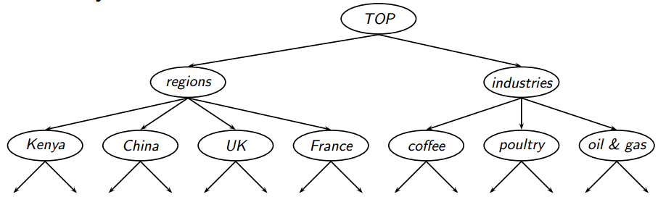
Hierarchical Classification
Image from Schütze & Krisnawati

Slide 6
Borges’s Classification
The list divides all animals into 14 categories:
Those that belong to the emperor
Embalmed ones
Those that are trained
Sucking pigs
Mermaids (or Sirens)
Fabulous ones
Stray dogs
Those that are included in this classification
Those that tremble as if they were mad
Innumerable ones
Those drawn with a very fine camel hair brush
Et cetera
Those that have just broken the flower vase
Those that, at a distance, resemble flies
Celestial Emporium of Benevolent Knowledge

Slide 7
Hand-coded Rules
Rules based on combinations of words or other features
spam: black-list-address OR (“dollars” AND “have been selected”)
Accuracy can be high
If rules carefully refined by expert
But building and maintaining these rules is expensive

Slide 8
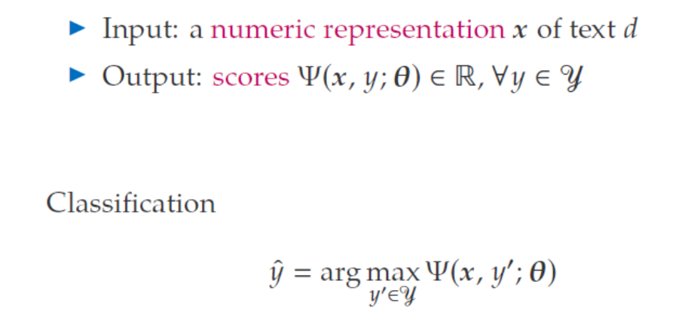
Mathematical Formulation

Slide 9
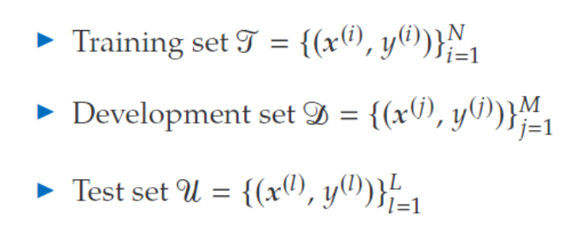
Mathematical Formulation

Slide 10
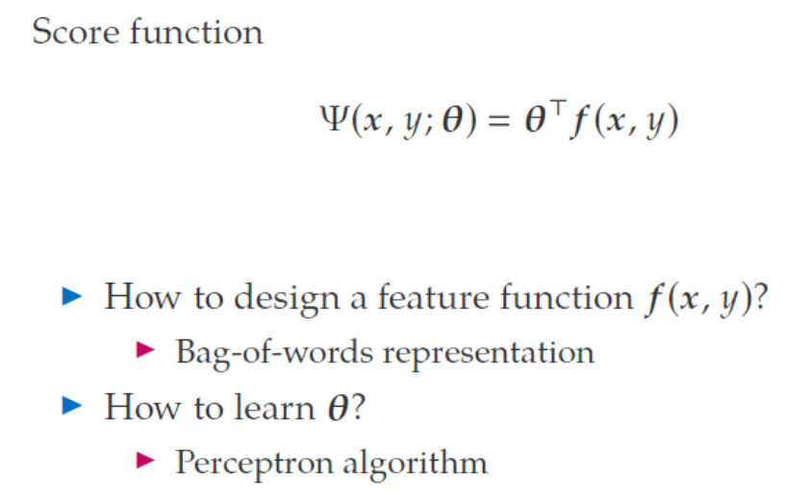
Mathematical Formulation

Slide 11
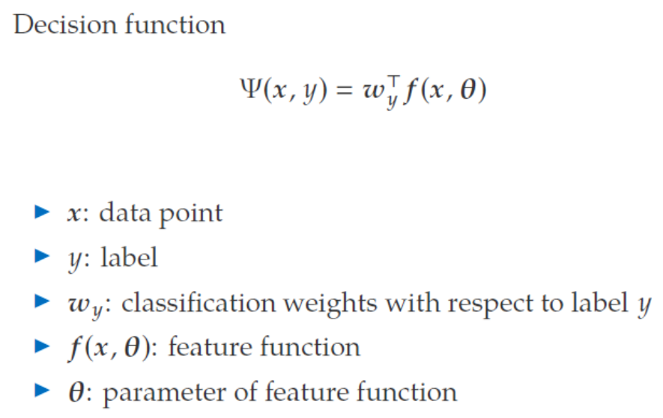
Mathematical Formulation

Slide 12
Spam Recognition
Return-Path: <*****@rediffmail.com>
X-Sieve: CMU Sieve 2.2
From: "Ibrahim Galadima" <*****@rediffmail.com>
Reply-To: galadima_esq@netpiper.com
To: *****
Subject: Gooday
DEAR SIR
FUNDS FOR INVESTMENTS
THIS LETTER MAY COME TO YOU AS A SURPRISE SINCE I HAD NO PREVIOUS CORRESPONDENCE WITH YOU
I AM THE CHAIRMAN TENDER BOARD OF INDEPENDENT NATIONAL ELECTORAL COMMISSION INEC I GOT YOUR CONTACT IN THE COURSE OF MY SEARCH FOR A RELIABLE PERSON WITH WHOM TO HANDLE A VERY CONFIDENTIAL TRANSACTION INVOLVING THE ! TRANSFER OF FUND VALUED AT TWENTY ONE MILLION SIX HUNDRED THOUSAND UNITED STATES DOLLARS US$20M TO A SAFE FOREIGN ACCOUNT

Slide 13
SpamAssassin
http://spamassassin.apache.org/
http://wiki.apache.org/spamassassin/HowScoresAreAssigned
http://spamassassin.apache.org/tests_3_3_x.html
Example features:
body Incorporates a tracking ID number
body HTML and text parts are different
header Date: is 3 to 6 hours before Received: date
body HTML font size is huge
header Attempt to obfuscate words in Subject:
header Subject =~ /^urgent(?:[\s\W]*(dollar) | .{1,40}(?:alert| response| assistance| proposal| reply| warning| noti(?:ce| fication)| greeting| matter))/i
Notes:
Open source spam filter
v.3.3.x tests are old, but the new tests change every night

Slide 14
Features for Classification
Vector-based
Words: “cat”, “dog”, “great”, “horrible”, etc.
Meta features: document length, author name, etc.
Each document (or sentence) is represented as a vector in an n-dimensional space
Similar documents appear nearby in the vector space
(more later)

Slide 15
Classification in NLP
Part of speech tagging
Sentiment analysis
Word sense disambiguation
Parsing
Optical character recognition
Spelling correction
Named entity classification

Slide 16
Introduction to NLP
Vector Space Classification

Slide 17
Vector Space Classification
x2
topic2
topic1
x1

Slide 18
Decision surfaces
x2
topic2
topic1
x1

Slide 19
Decision trees
x2
topic2
topic1
x1

Slide 20
Classification Using Centroids
Centroid
the point most representative of a class
Compute centroid by finding vector average of known class members
Decision boundary is a line that is equidistant from two centroids.
New document on one side of the goes in one class; new document on the other side goes in the other.

Slide 21
Linear boundary
x2
topic2
topic1
x1

Slide 22
Classification Using Centroids
x2
topic2
topic1
centroid2
centroid1
x1

Slide 23
Introduction to NLP
Linear Classifiers

Slide 24
Decision Boundary

Slide 25
Decision Boundary

Slide 26
Decision Boundary

Slide 27
Decision Boundary
x

Slide 28
Decision Boundary
x
w

Slide 29
Linear Separators
Two-dimensional line:
w₁x₁+w₂x₂=b is the linear separator
w₁x₁+w₂x₂>b for the positive class
In n-dimensional spaces:
One can also add w₁=1, x₀=b (constant)
w is the weight vector
x is the feature vector
${\vec{w}}^{T}\vec{x}=\sum_{i=1}^{n}{w_{i}x_{i}}=w1x1+w2x2+…+wnx$_{n}

Slide 30
Example
w_{i} | x_{i} | w_{i} | x_{i}
0.6 | A | -0.7 | G
0.5 | B | -0.5 | H
0.5 | C | -0.3 | I
0.4 | D | -0.2 | J
0.4 | E | -0.2 | K
0.3 | F | -0.2 | L
Bias b=0 (in this example)
Sentence is “A D E H”
Its score will be
0.6*1+0.4*1+0.4*1+(-0.5)*1 = 0.9>0

Slide 31
How to Find the Linear Boundary?
Find the linear boundary = find
Many methods
E.g., Perceptron
Problem:
There are infinite number of linear boundaries if the two classes are linearly separable!
Maximum margin: Support Vector Machines (SVM)
x₂
+
+
+
+
+
+
+
+
+
-
+
+
-
+
+
-
-
-
-
-
-
-
-
-
-
-
-
-
x₁

Slide 32

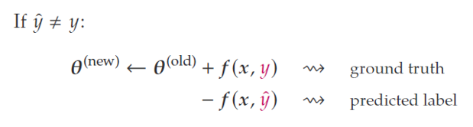
General Training Idea
Go through the training data
Predict the class y (1 or -1)
If the prediction is wrong, update θ

Slide 33
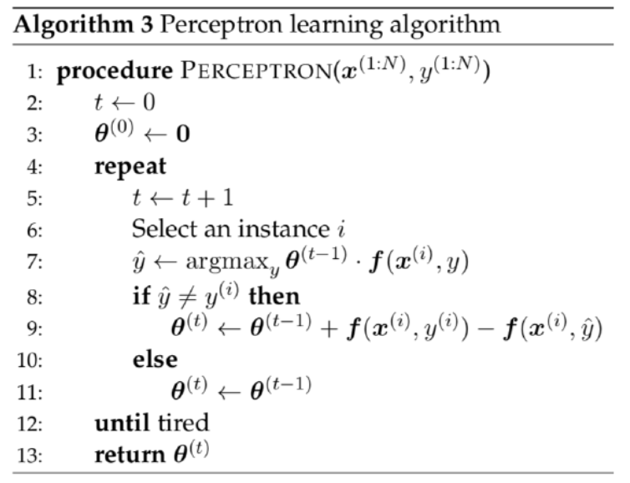
Perceptron Algorithm (preview)

Slide 34
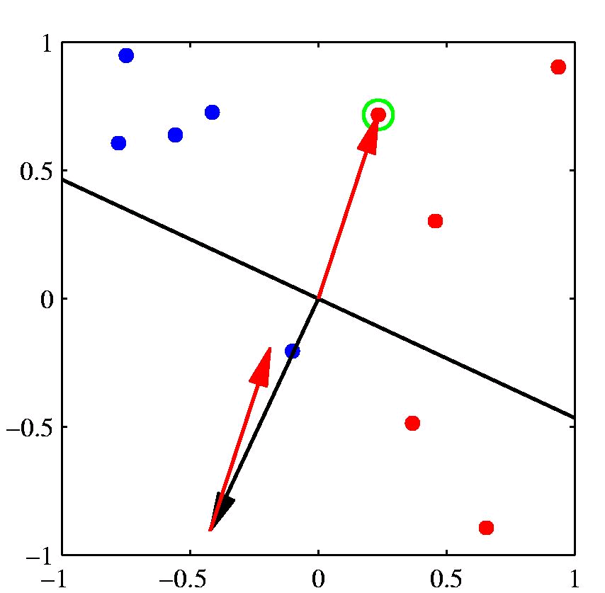
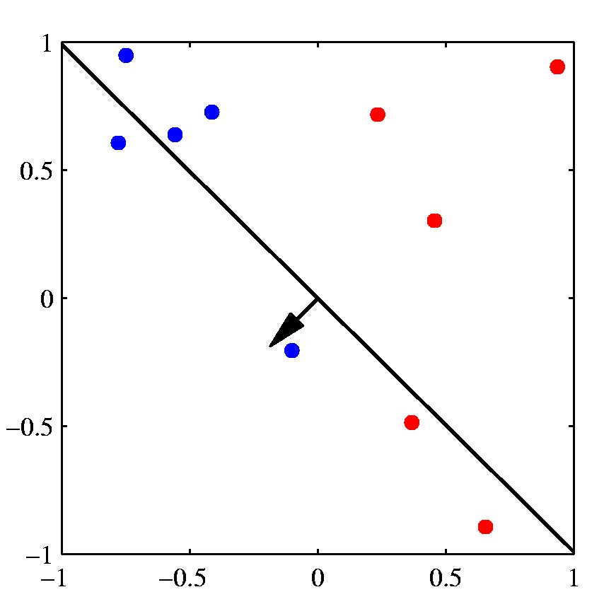
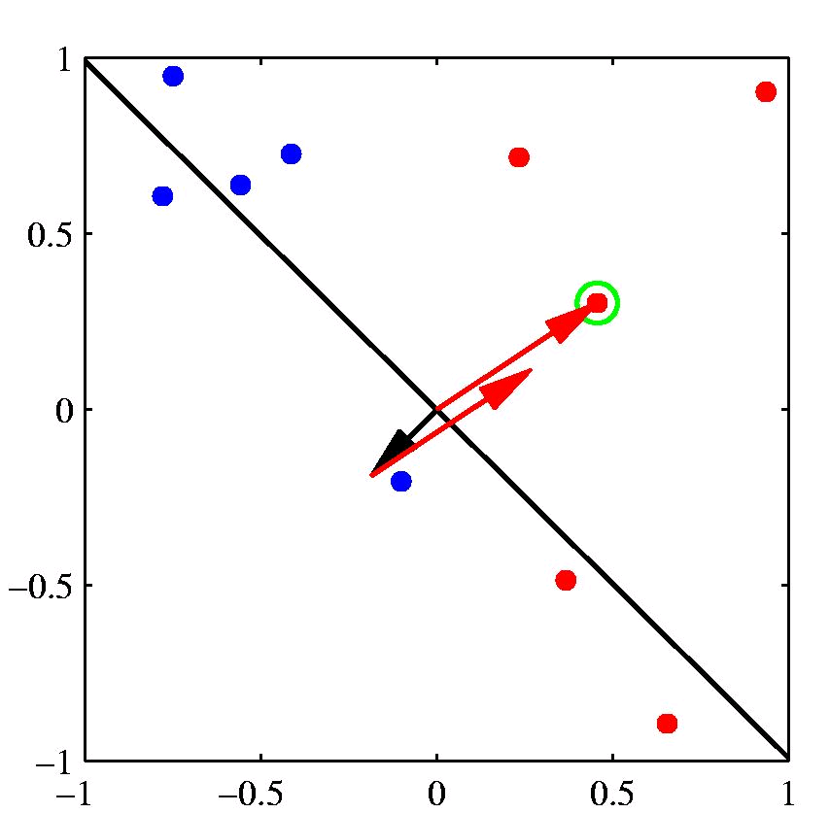
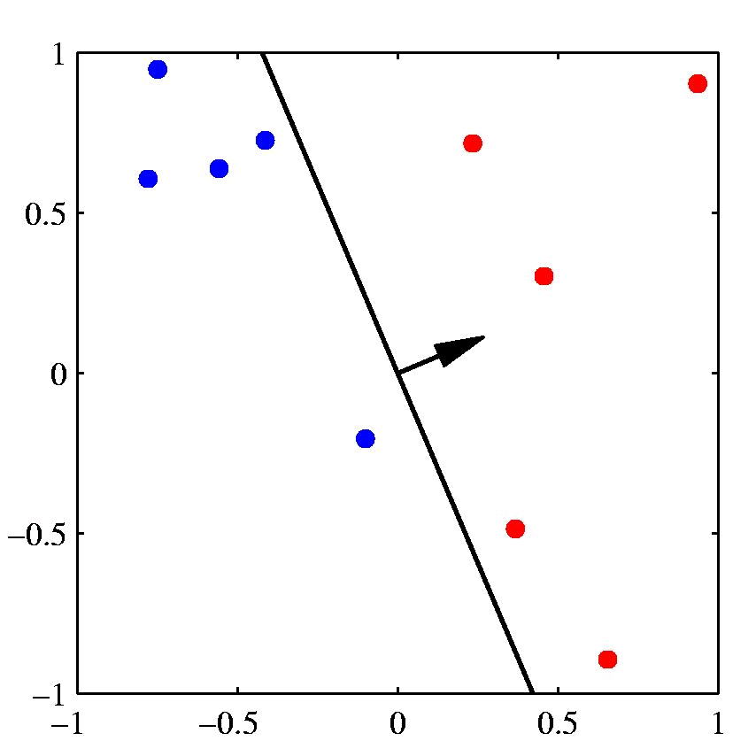
[Example: Chris Bishop]

Slide 35
Example with Interpolation
Linear interpolation for language modeling
Estimating the trigram probability P(c|ab) using P_{MLE}(c|a), P_{MLE}(c), etc.
Weights λ₁, λ₂, etc.
We may want to consider other features
E.g., POS tags of previous words, heads, word endings, etc.
General idea
Compute the conditional probability P(y|x)
P(y|x) = sum of weights*features
Label Y for a given history x in X

Slide 36
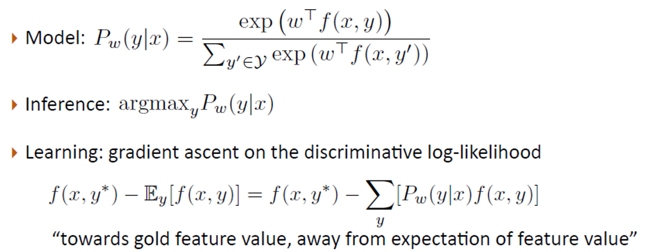
Logistic Regression (preview)
[discriminative method]
[Greg Durrett]

Slide 37
Naïve Bayes (preview)
Multinomial Naïve Bayes is a linear model
x = [1, x₁, x₂ …]
w = [log P(y), log P(w₁|y), log P(w₂|y) …]

Slide 38
NLP

